Slide 1

Taro Tanaka 1234567890
Ninki University
Economics
MY
LIFE

Slide 2
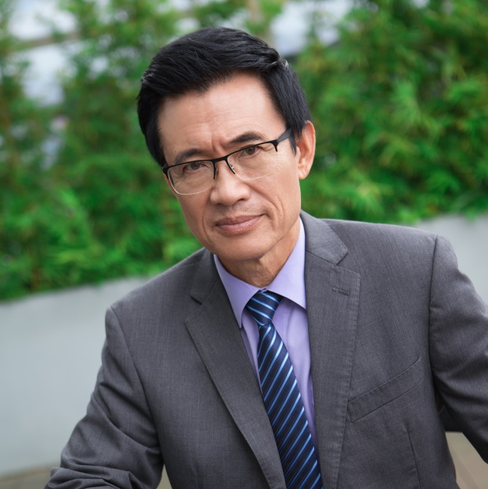
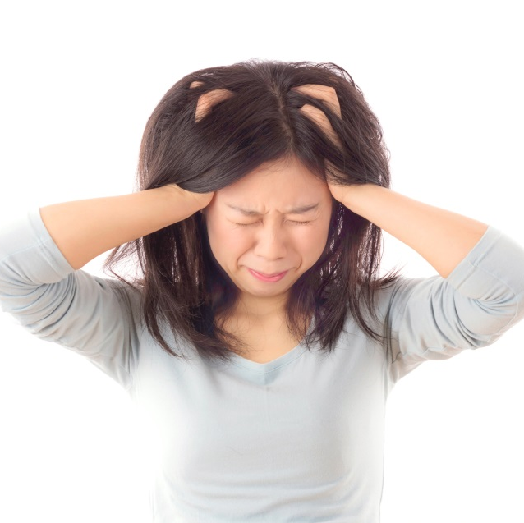

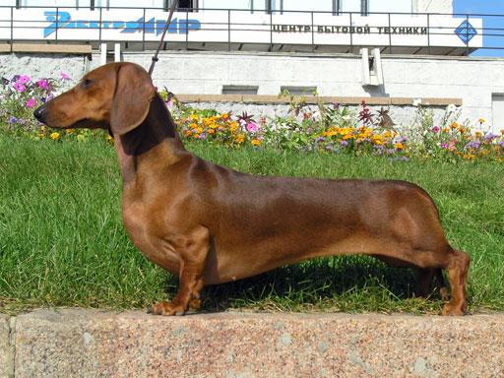
MY FAMILY
Serious
Angry
Long
Crazy

Slide 3
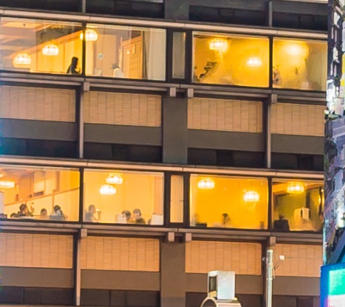
MY HOMETOWN
“A” Tokyo
“B” Kobe
“C” Osaka
Where???

Slide 4

MY HOMETOWN
OSAKA

Slide 5


Slide 6


Slide 7

Taro Tanaka
Thanks
For
Listening!

Slide 8
Photos credits:
Slide #1: Created by Asierromero - Freepik.com
Slide #2.1: Created by Katemangostar - Freepik.com
Slide #2.2: Created by Evening_tao - Freepik.com
Slide #2.3: Short-haired-Dachshund – WikiMediaCommons
Slide #2.4: Created by Asier_relampagoestudio - Freepik.com
Slide #3, #4: Created by Mrsiraphol - Freepik.com
Slide #5: Created by Asierromero - Freepik.com
Slide #6: Created by Jannoon028 - Freepik.com
Slide #7: Created by Asier_relampagoestudio - Freepik.com

