Slide 1
The English Gym
Self-Study Guidelines
Unit 3: Your neighborhood

Slide 2
Unit 3: Your Neighborhood
Step by step instructions
Study time: 90 minutes

Slide 3
If you did not buy your book yet, you can download and print the documents you received from your teacher for Unit 3 or you can go to this website: englishgymjapan.com/online If you don’t have access to a printer at home, try a convenience store. Or, just look at the unit online and take notes in a notebook. You can re-write them again in your textbook later. *Unit 3 is the LAST unit you can download. You need to buy your book to do the other units.
You will need your textbook: The English Gym
Author: Jon Charles ISBN 978-4-9909741-0-7

Slide 4
Page 26 Listening Step 1: Fill in the blanks with words from the list. Step 2: Go to: englishgymjapan.com Listen to audio track 3.
Check the questions and also write or circle the answers that you hear on the right side.
(You will check the answers later.)

Slide 5
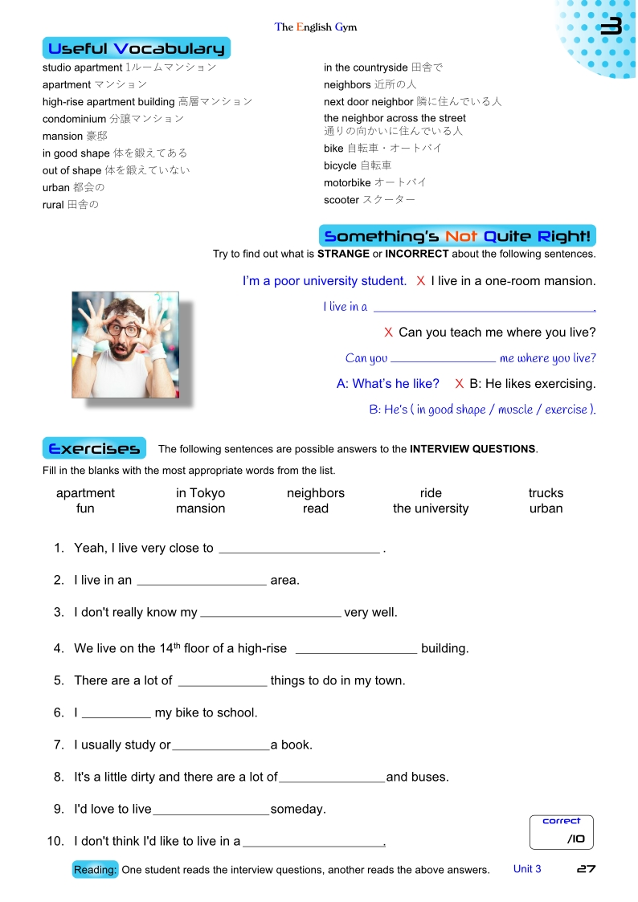
Page 27
Step 1:
Useful Vocabulary
Study these words.
(Be careful of the words outlined in red.)
Step 2:
Something’s Not Quite Right
Try to correct the sentences.

Slide 6
Page 27
Step 3: Exercises
Fill in the blanks with the words from the list. These sentences are possible answers to the questions on page 26.

Slide 7
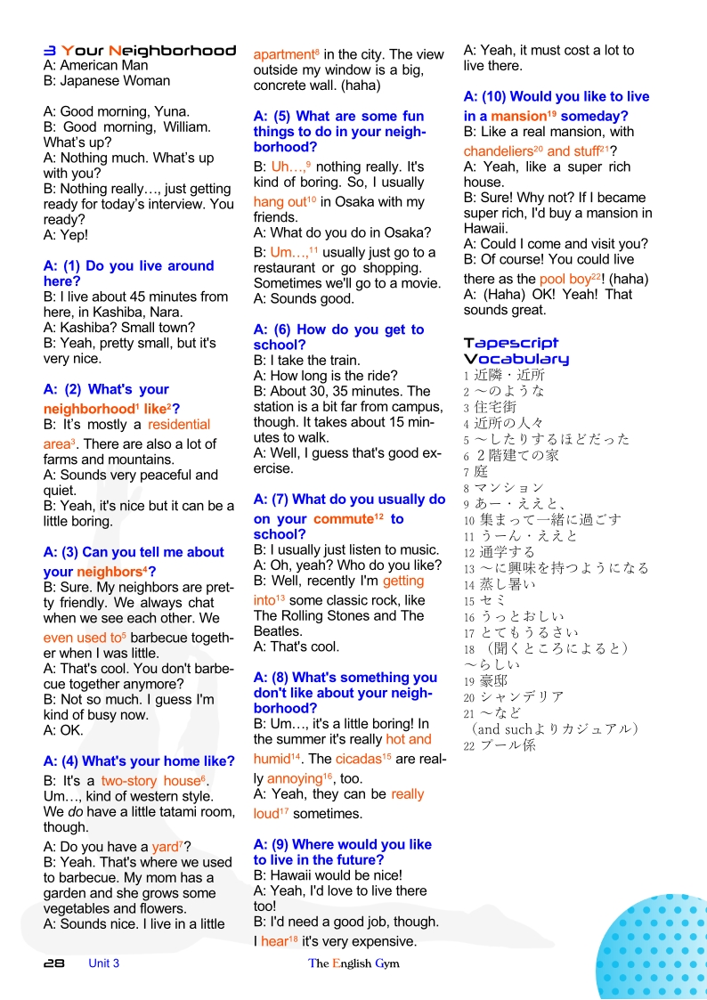
Page 28 Tapescript Step 1: Look at the words in red and check the definitions. Step 2: Read the tapescript aloud. (You can listen again to the audio and try to read at the same time.)
Check your answers from page 26.

Slide 8
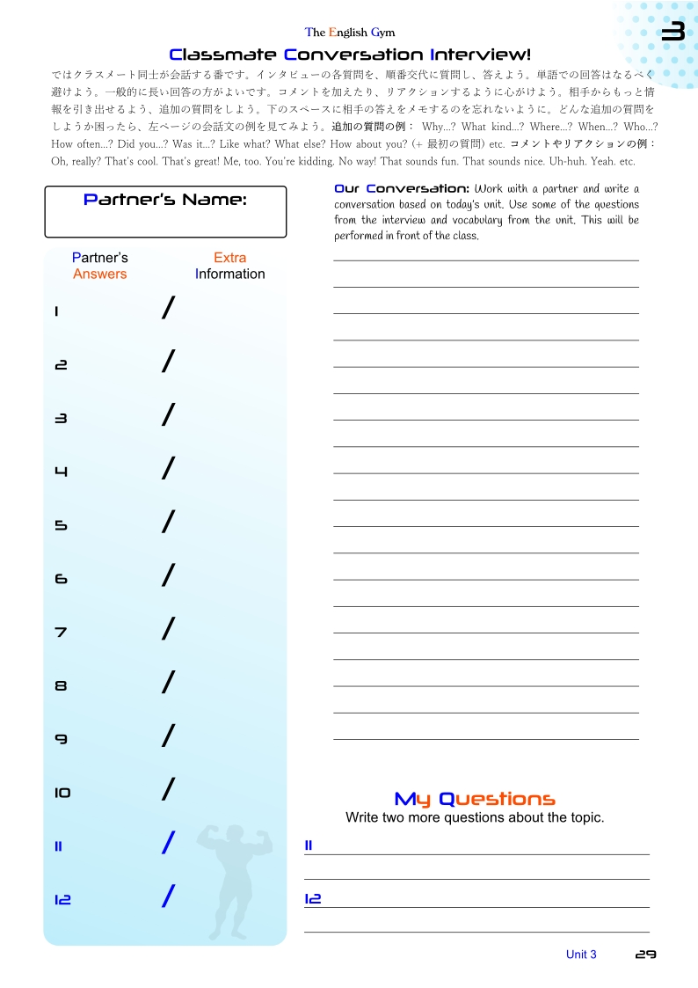
Page 29 Step 1: Conversation Interview Please read the instructions. If you have a partner, please have a conversation together. If you don’t have a partner, write your own answers.
Take a few notes next to the numbers. Don’t forget Extra Information!
Try your best to speak in English!

Slide 9
Page 29 Our Conversation Step 2: Write a dialogue using one of the interview questions as a starting point. Try to use new vocabulary. Try to make the conversation funny or interesting in some way. Make sure you have comments, reactions, and follow-up questions. Write at least 150 words.
Example
A: So, Taro, what’s your home like?
B: Well, in live on the 14th floor of a high-rise apartment building.
A: That’s cool. You must have a pretty nice view!
B: Yeah, the view is beautiful.
A:….. (write 150 words)

Slide 10
You can study more on the student’s web page
englishgymjapan.com/study-vocabulary

Slide 11
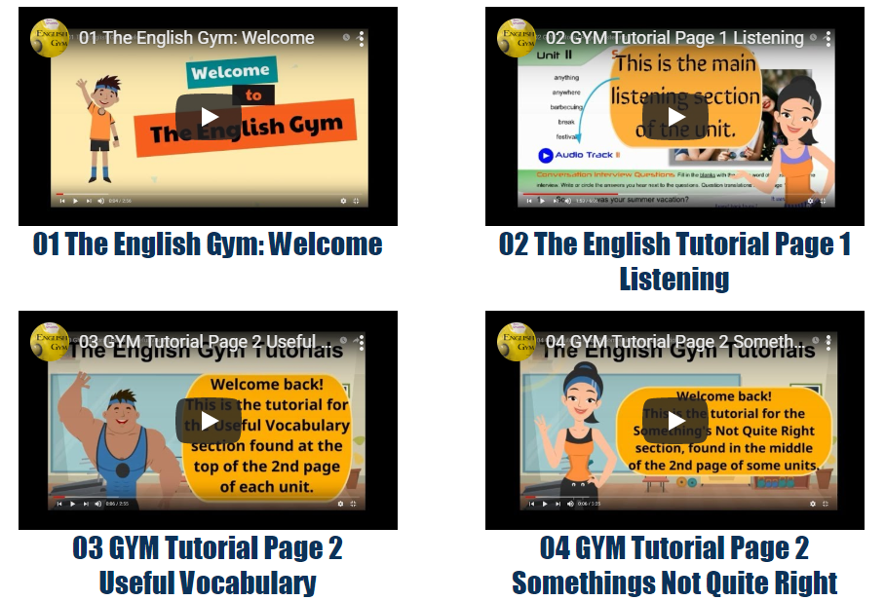
You can watch some teacher tutorials here
englishgymjapan.com/video-tutorials-for-teachers
These videos are designed for teachers, but students can watch and learn, too!

Slide 12
Thanks for studying with The English Gym!
Please submit your homework through the university system. Teachers can add links, contact information, or more instructions here.

