Slide 1

Taro Tanaka 1234567890
Ninki University
Economics
MY
LIFE

Slide 2
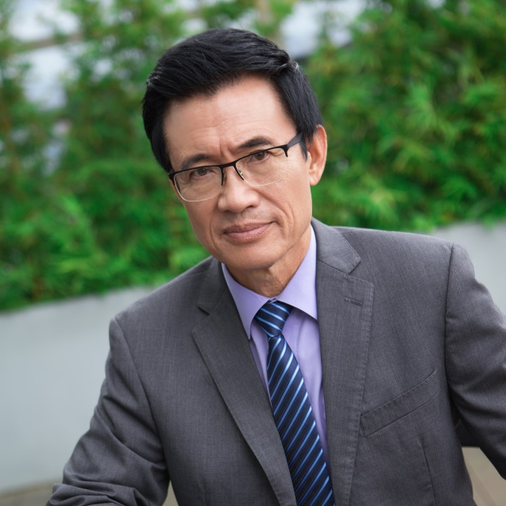


MY FAMILY
Serious
Busy
Funny

Slide 3
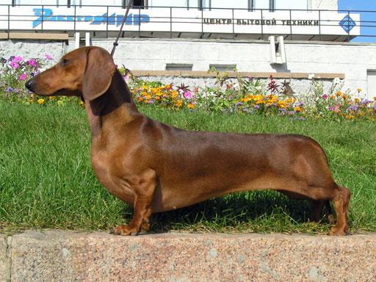
My Pet: Hot Dog

Slide 4
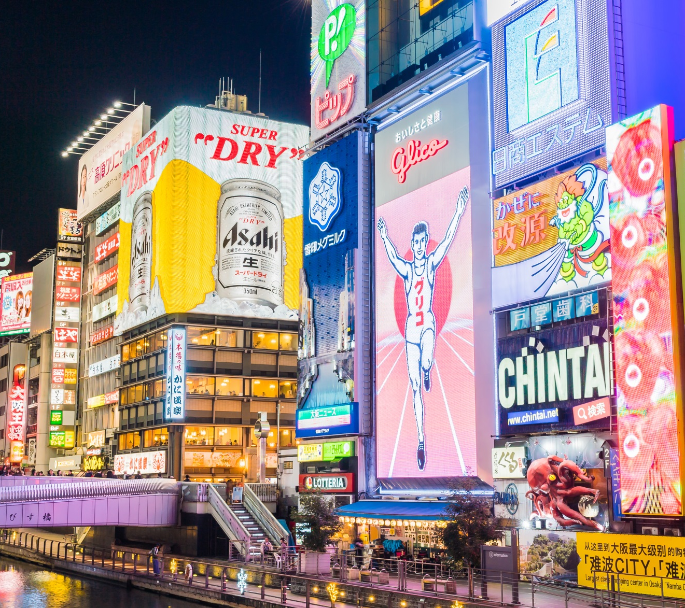
MY HOMETOWN
OSAKA

Slide 5


Slide 6
Taro Tanaka
Thanks
For
Listening!

Slide 7
Photos credits:
Slide #1: Created by Asierromero - Freepik.com
Slide #2.1: Created by Katemangostar - Freepik.com
Slide #2.2: Created by Evening_tao - Freepik.com
Slide #2.3: Created by Asier_relampagoestudio - Freepik.com
Slide #3: Short-haired-Dachshund – WikiMediaCommons
Slide #4, #4: Created by Mrsiraphol - Freepik.com
Slide #5: Created by Asierromero - Freepik.com

